Slide 1
Technical Bootcamp
Week 4
Akshita Verma
Associate Data Engineer

Slide 2
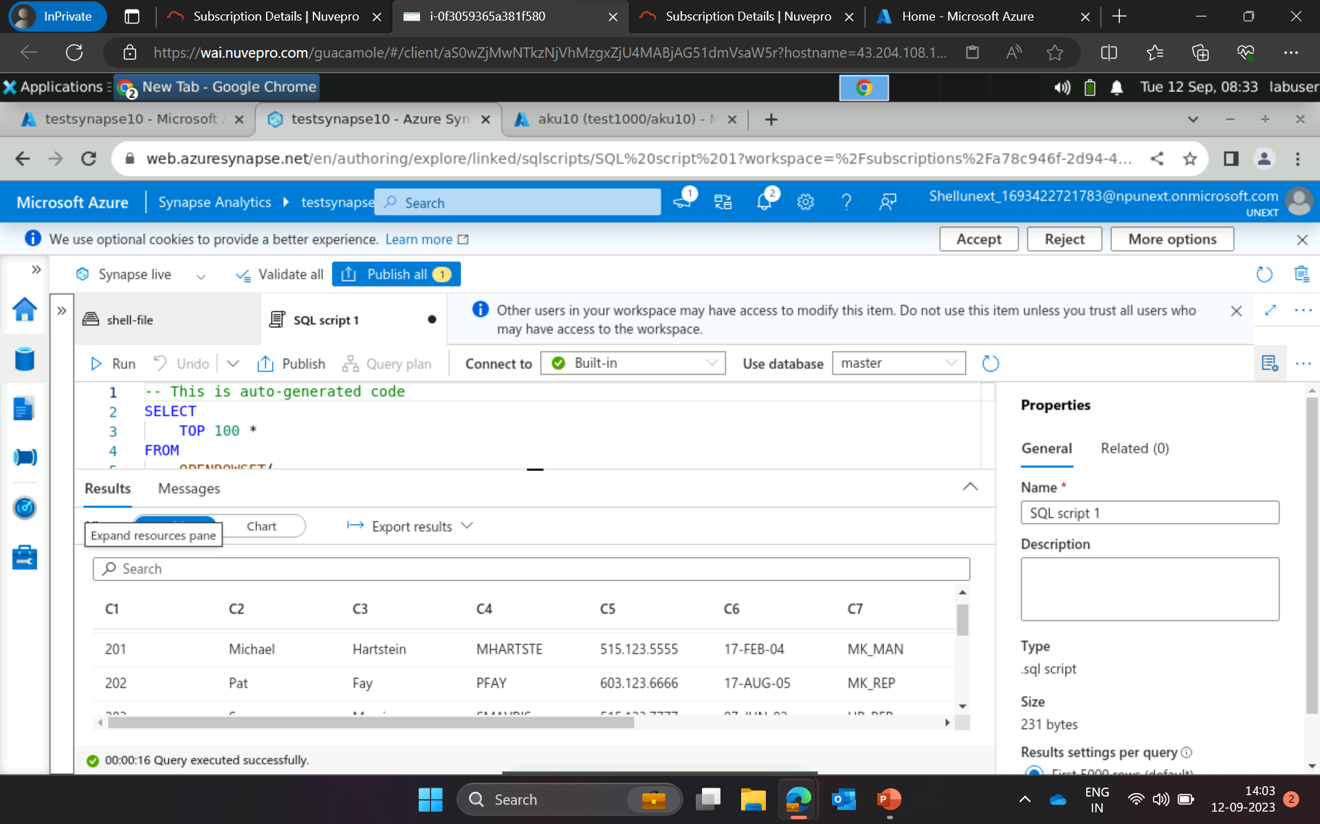
Azure Synapse

Slide 3
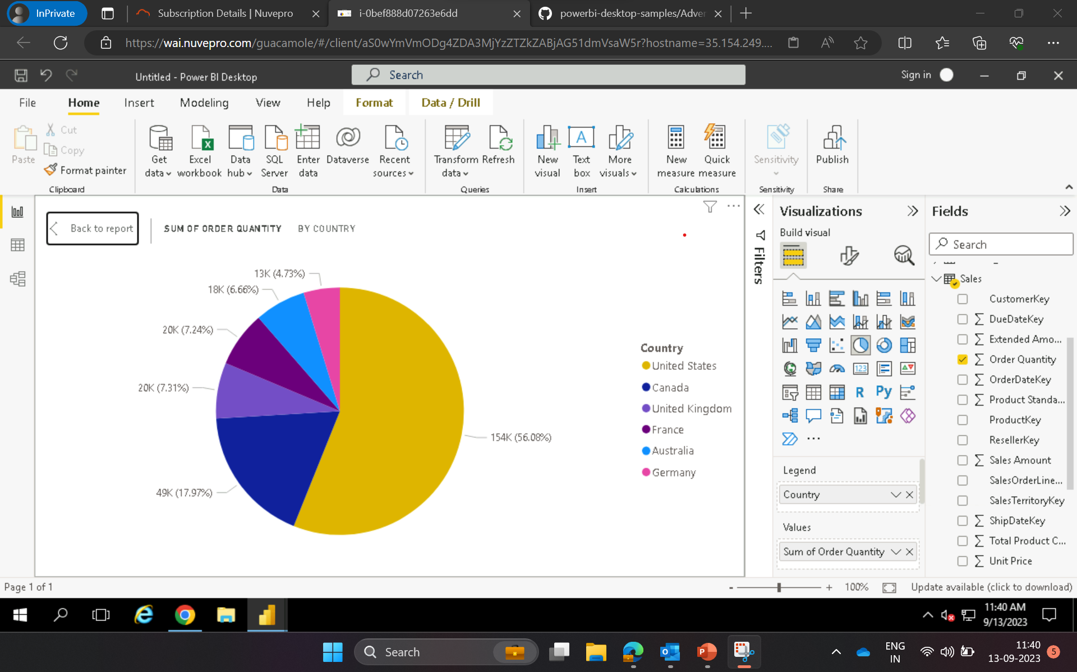
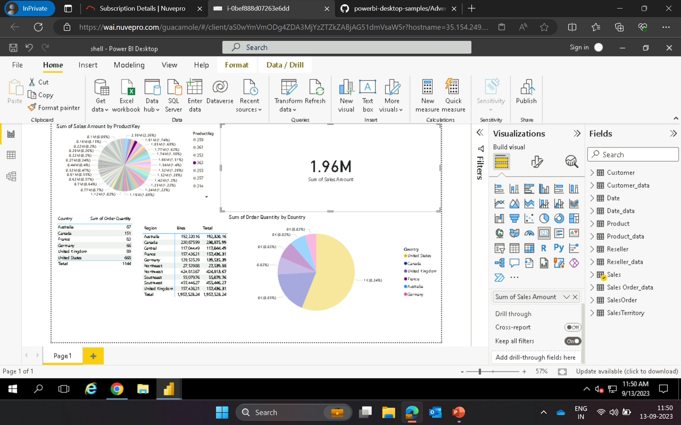
Power BI

Slide 4
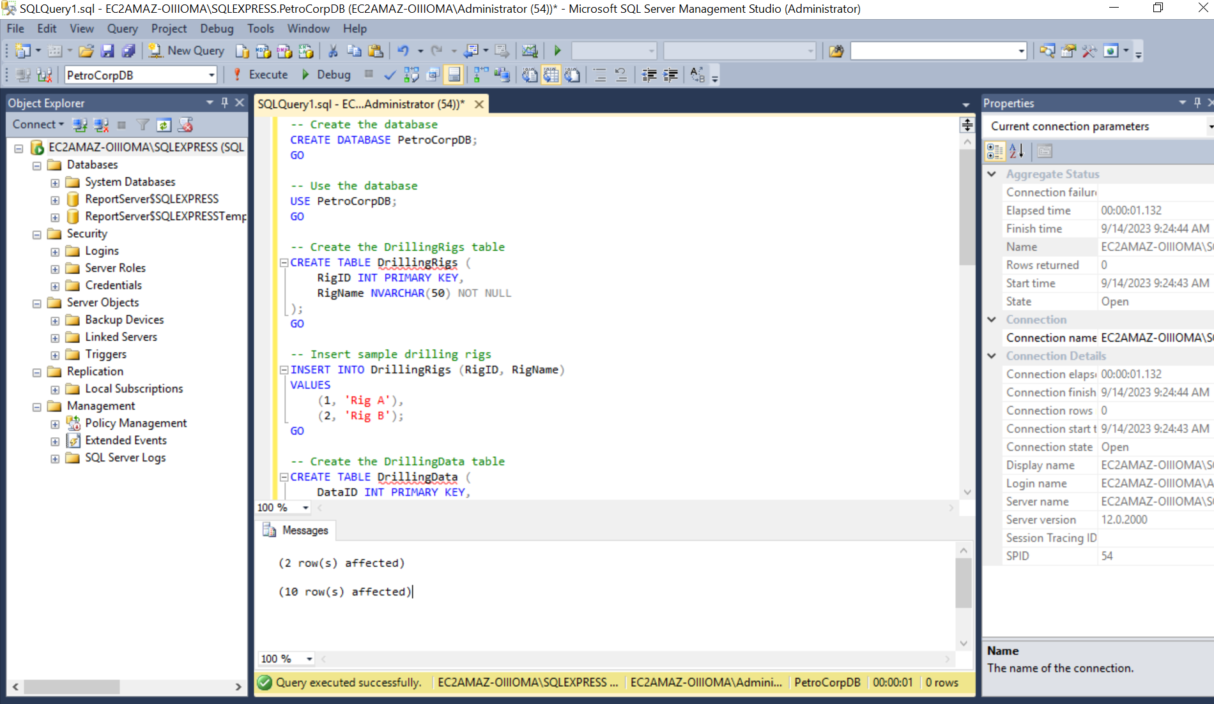
PowerBI Import and present data from SQL server

Slide 5
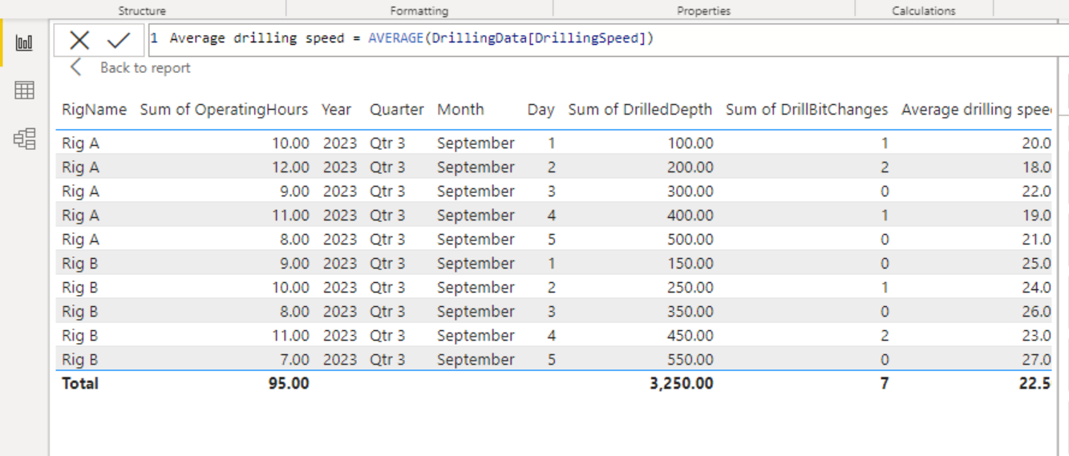
Assignment: PetroCorp Business Requirements for PowerBi

Slide 6
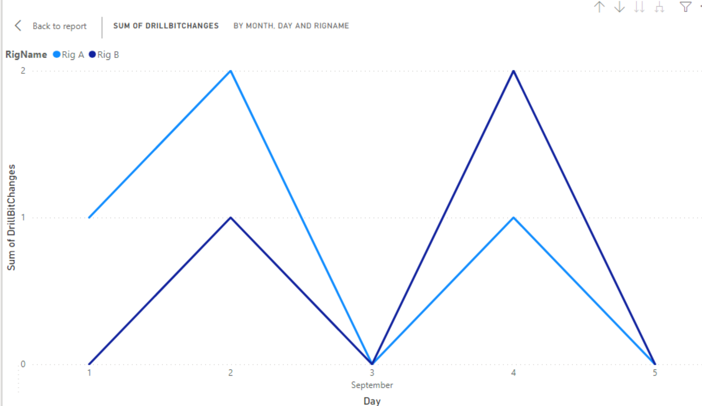
Assignment: PetroCorp Business Requirements for PowerBi

Slide 7
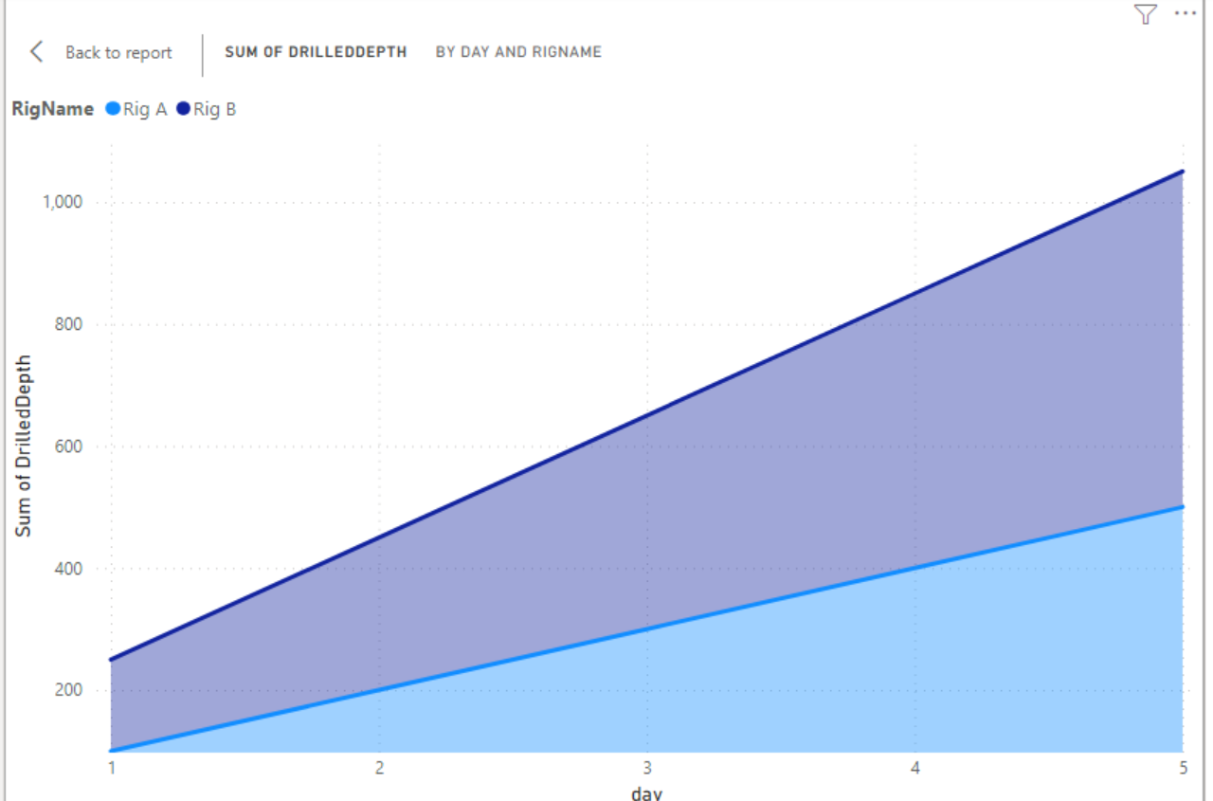
Assignment: PetroCorp Business Requirements for PowerBi

Slide 8
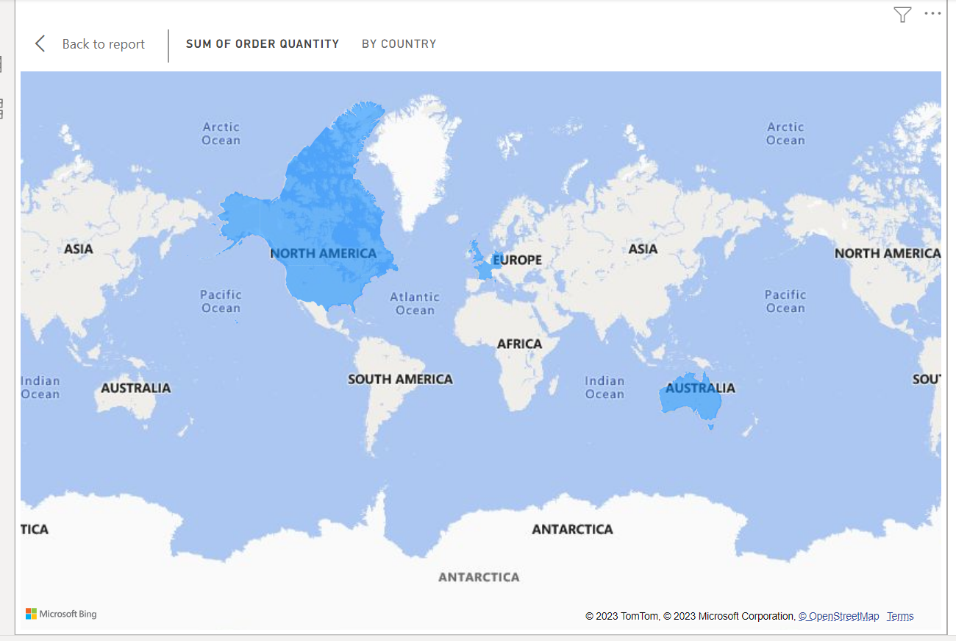
Geo spatial data using maps in PowerBi

Slide 9
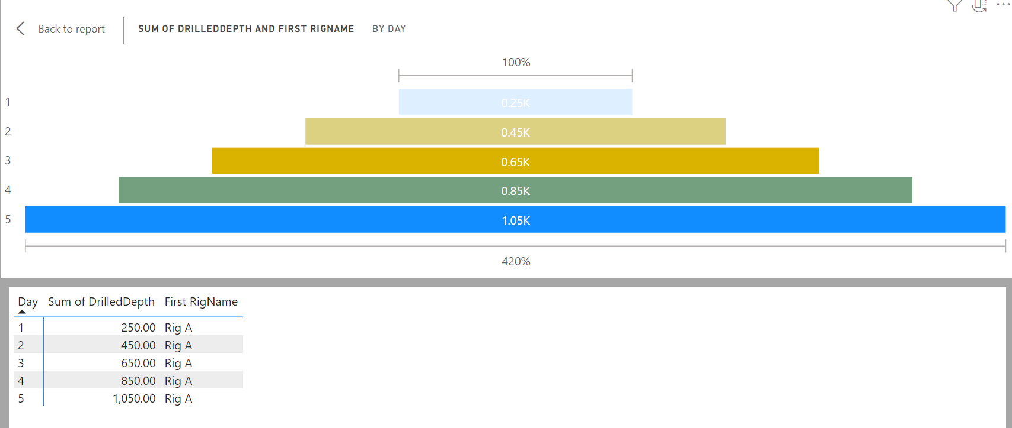
Funnel chart

Slide 10
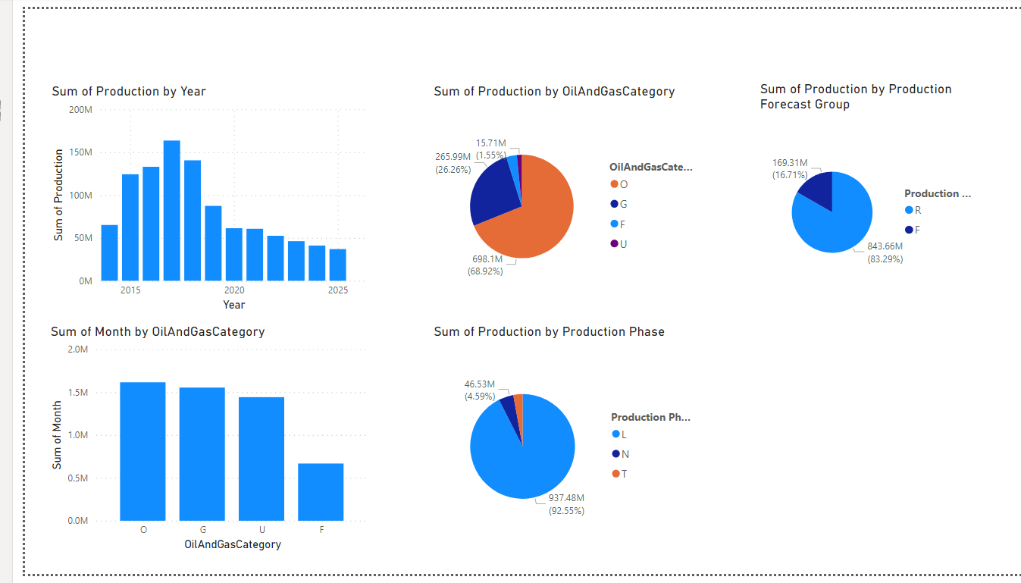
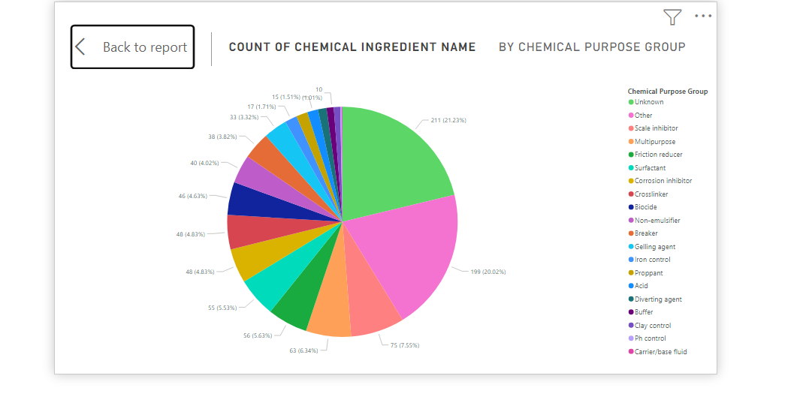
Assignment : Prepare report on PowerBi for wells data

Slide 11
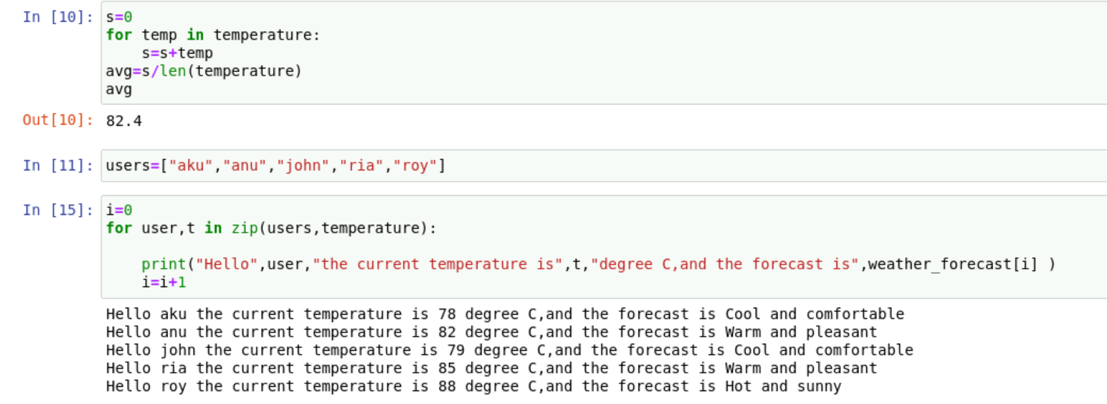
Python basics
Data types: int ,str ,tuple, list, dictionary
Enumerate,zip
If else conditions

